Slide 1


DS501 Statistical and Mathematical methods for Data Science
Lecture Week 12
Analysis of Variance (ANOVA)
Certified Data Analyst [KARACHI.AI]

Slide 2
ANALYSIS OF VARIANCE (ANOVA)
Introduction:
Analysis of Variance (ANOVA) is a hypothesis-testing technique used to test the equality of two or more population (or treatment) means by examining the variances of samples that are taken.
ANOVA allows one to determine whether the differences between the samples are simply due to random error (sampling errors) or whether there are systematic treatment effects that causes the mean in one group to differ from the mean in another.
Most of the time ANOVA is used to compare the equality of three or more means, however when the means from two samples are compared using ANOVA it is equivalent to using a t-test to compare the means of independent samples.

Slide 3
ANALYSIS OF VARIANCE (ANOVA)
ANOVA is based on comparing the variance (or variation) between the data samples to variation within each particular sample.
If the between variation is much larger than the within variation, the means of different samples will not be equal.
If the between and within variations are approximately the same size, then there will be no significant difference between sample means.
Assumptions of ANOVA:
(i) All populations involved follow a normal distribution.
(ii) All populations have the same variance (or standard deviation).
(iii) The samples are randomly selected and independent of one another.

Slide 4
ANALYSIS OF VARIANCE (ANOVA)
Since ANOVA assumes the populations involved follow a normal distribution, ANOVA falls into a category of hypothesis tests known as parametric tests.
If the populations involved did not follow a normal distribution, an ANOVA test could not be used to examine the equality of the sample means.
Instead, one would have to use a non-parametric test (or distribution-free test), which is a more general form of hypothesis testing that does not rely on distributional assumptions.

Slide 5
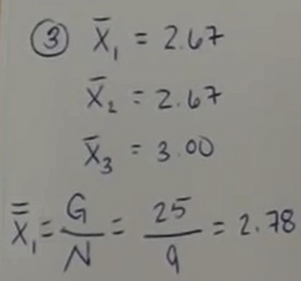
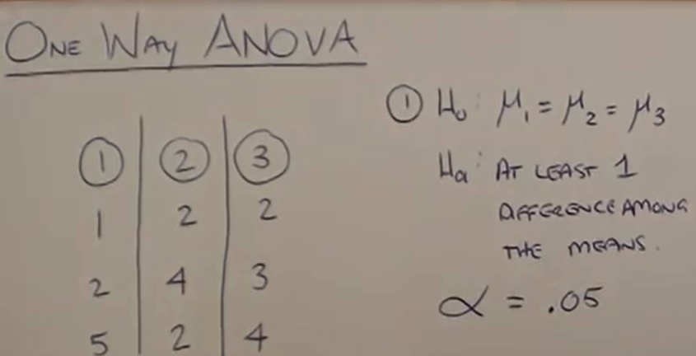

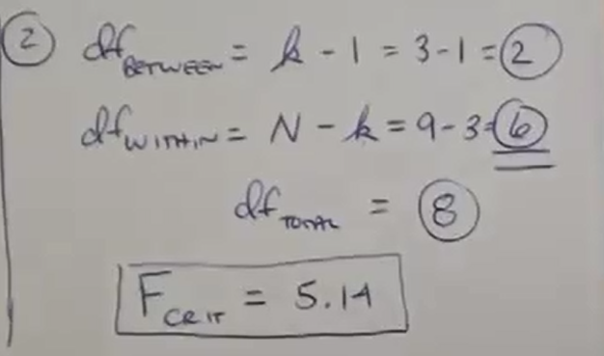
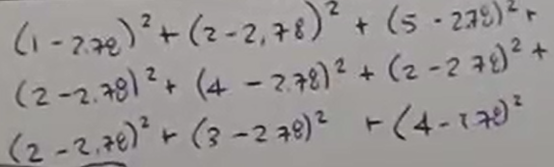

ANALYSIS OF VARIANCE (ANOVA)

Slide 6
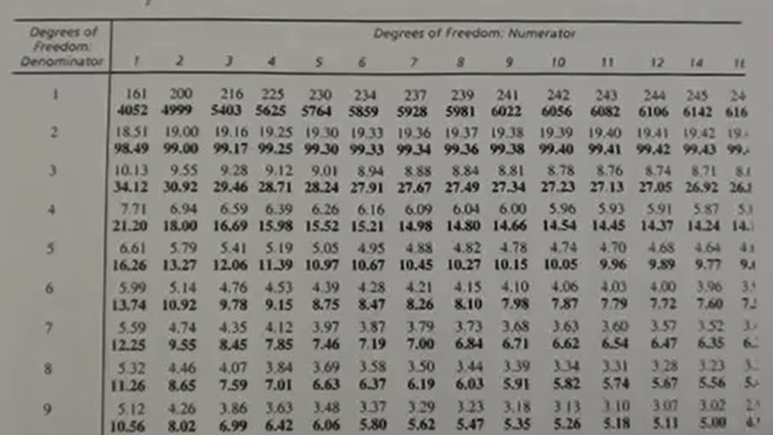
ANALYSIS OF VARIANCE (ANOVA)

Slide 7
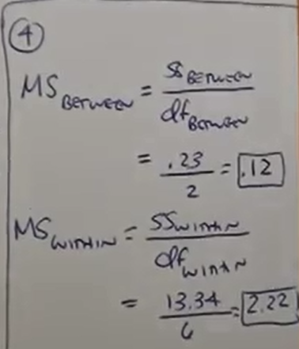
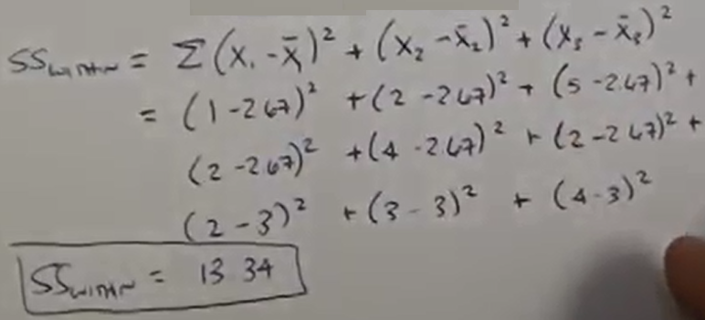
ANALYSIS OF VARIANCE (ANOVA)

Slide 8
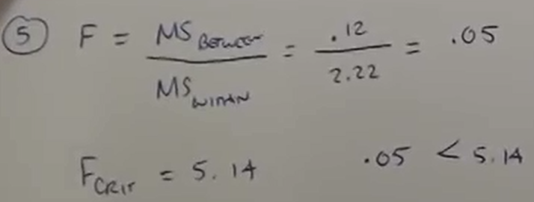
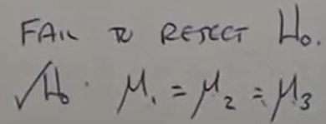
ANALYSIS OF VARIANCE (ANOVA)

Slide 9
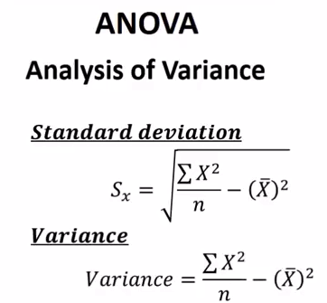
ANALYSIS OF VARIANCE (ANOVA)

Slide 10
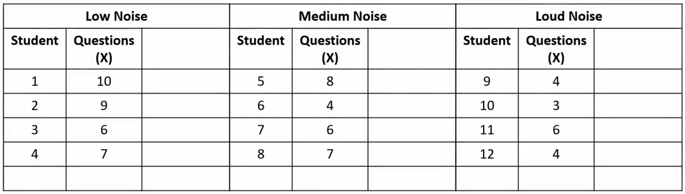
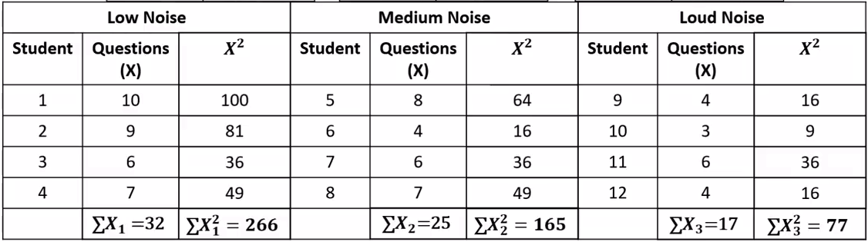
ANALYSIS OF VARIANCE (ANOVA)

Slide 11
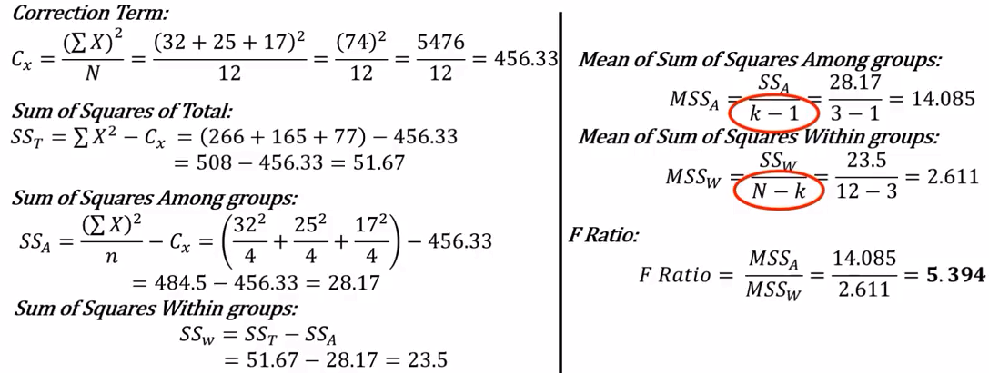
ANALYSIS OF VARIANCE (ANOVA)

Slide 12
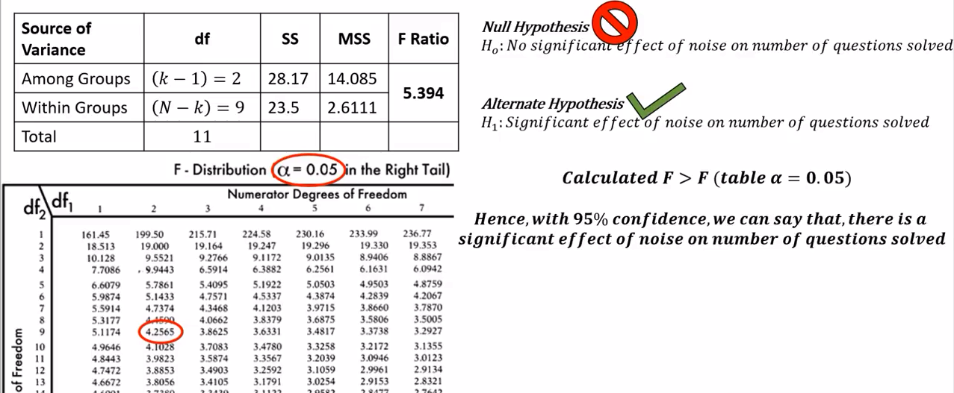
ANALYSIS OF VARIANCE (ANOVA)

Slide 13
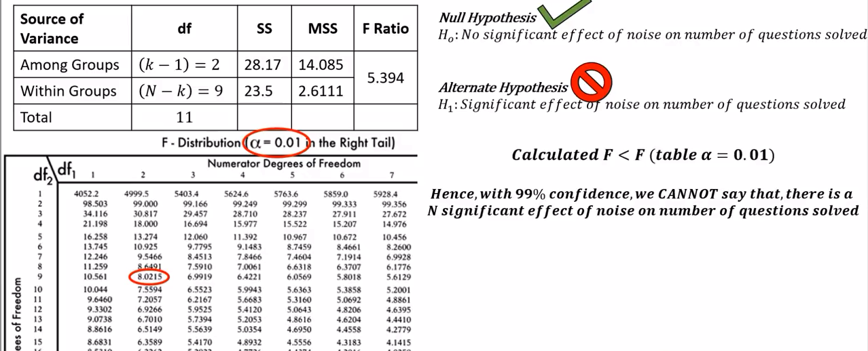
ANALYSIS OF VARIANCE (ANOVA)

